Slide 1

Ulcerative Colitis Prediction Classification Project
Presented by:
Yulia Ryvkin
Ya'eer Kidron
Yair Toledano

Slide 2

Background
Ulcerative colitis (UC) is an inflammatory bowel disease (IBD) diagnosed primarily in young individuals.
Complex diseases such as UC, present highly heterogeneous genotypes, which makes it difficult to identify biological markers.
Machine learning methods are widely used to identify these markers, but their performance is highly dependent upon the size and quality of available data.
A Greater understanding of UC patients gene expression is needed for proper diagnosis and early disease detection.
For this purpose, we developed a supervised machine learning methodology to UC illness based on gene expression.

Slide 3
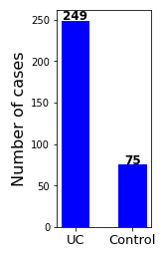
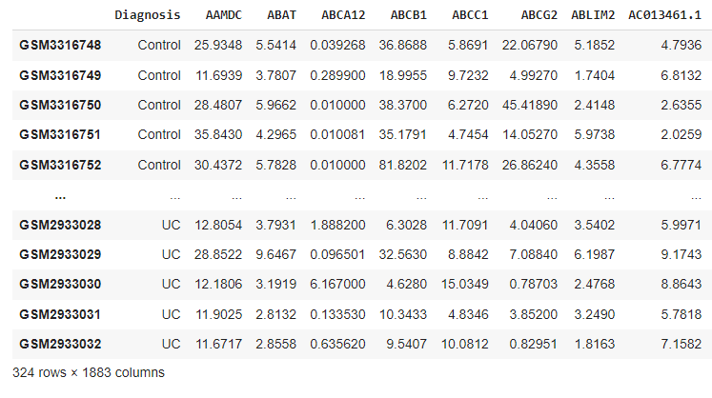
Data Overview
Data was obtained from Haberman et al. Nat Commun(2019)
Columns consist of 1882 Differentially expressed genes (DEGs) of UC patients compared to controls
Diagnosis

Slide 4
EDA Data Cleaning and scaling
RobustScaler
quantile_range = (1, 99)
Notes:
One approach to standardizing input variables in the presence of outliers is to ignore the outliers from the calculation of the mean and standard deviation, then use the calculated values to scale the variable.
This is called robust standardization or robust data scaling.
This can be achieved by calculating the median (50th percentile) and the 25th and 75th percentiles. The values of each variable then have their median subtracted and are divided by the interquartile range (IQR) which is the difference between the 75th and 25th percentiles.
value = (value – median) / (p75 – p25)
Scale features using statistics that are robust to outliers.
This Scaler removes the median and scales the data according to the quantile range (defaults to IQR: Interquartile Range). The IQR is the range between the 1st quartile (25th quantile) and the 3rd quartile (75th quantile).

Slide 5
EDA Gene relative read counts distribution of UC and control groups
UC group
Control group
The control group counts distribution is more heterogenous compared to the UC group

Slide 6
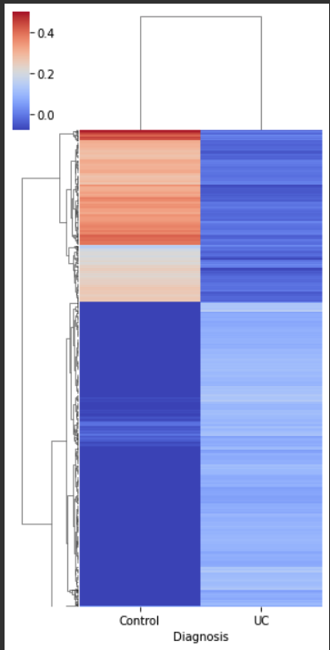
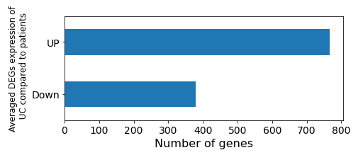
EDA UC group gene expression compared to the control group
Averaged relative gene expression
Calculating the number of genes, which expression was at least x2 greater or lower in UC patients compared to controls, revealed that the majority of genes was down-regulated

Slide 7
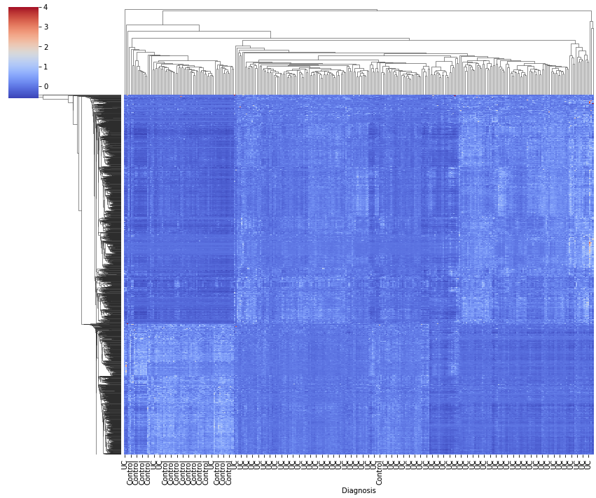
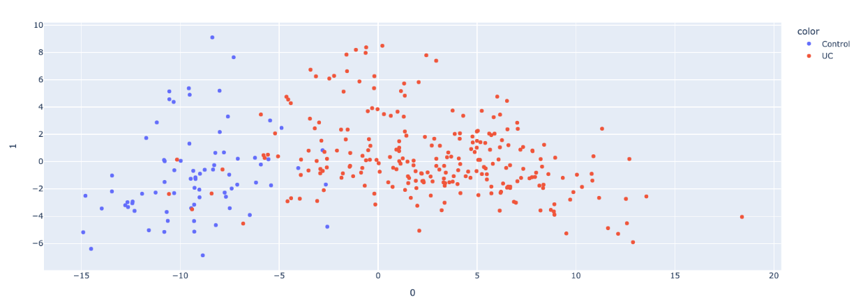
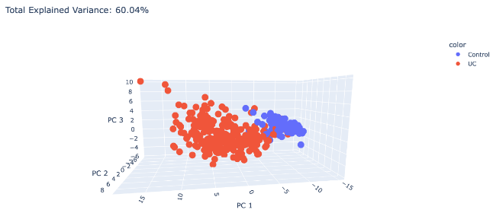
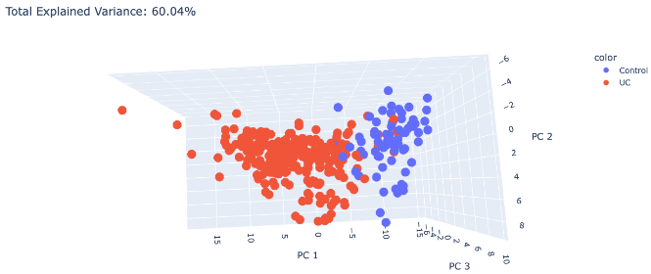
EDA Evaluation of group separation using PCA and heatmap
PCA graph shows a relatively good group separation, as most of the samples of each group were clustered adjacent to each other, with a low number of samples leaking to the neighboring group
Most UC and Control samples were clustered together, and showed a unique gene expression

Slide 8
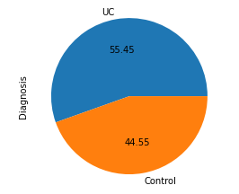
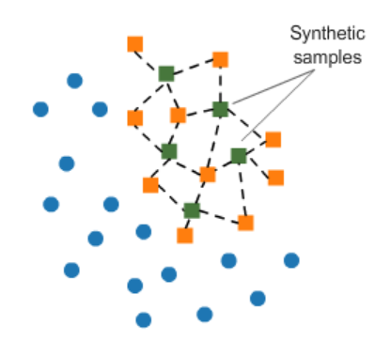
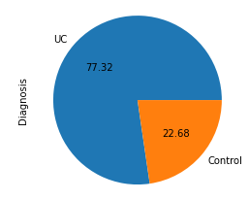
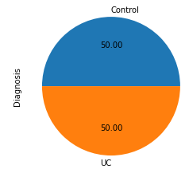
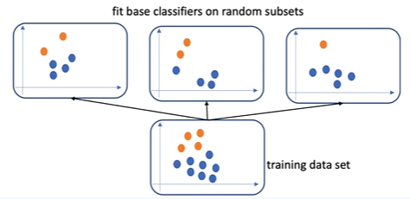
EDA Dealing with imbalanced data
Imbalanced Data
SMOTE
BalancedBaggingClassifier

Slide 9
Modeling Finding the right scorer
Our model strives to identify a predisposition to UC by the patient's expressed genes.
X
FN = a sick patient is diagnosed as healthy
FP = a healthy patient is diagnosed as sick
leads us to focus more on the Precision score
However, counting on the Precision score alone could lead to classifying all patients as sick
F1
Accuracy
F beta, weight= 0.8
(Precision slightly more important)

Slide 10


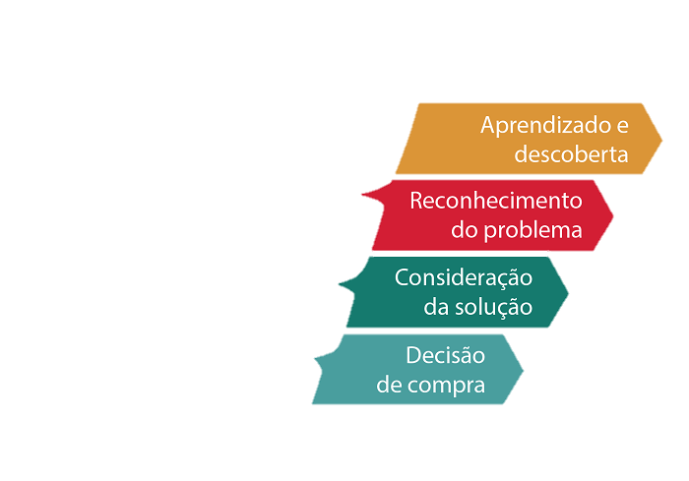

Modeling Pipeline
Scores used: F1, Accuracy, f beta
Classes and methods:
RF, LR, NB, DT, SVC
Cross Validation & Grid_search
Voting\Bagging
Kidron Classifier
PCA
The scores for each class and its grid_param were reviewed
Model Classifications
Classes Grid Parameters
SMOTE /Class weight w\or Bagging
Grid Search

Slide 11
Modeling Model Comparisons
SVC | Naive Bayes | Logistic Regression | Decision Tree | Class Score
0.9844 | 0.9559 | 0.9792 | 0.9769 | F1 | Grid Search Pipeline
0.9849 | 0.9569 | 0.9798 | 0.9771 | Accuracy
0.8808 | 0.9044 | 0.9266 | 0.9273 | F Beta
0.9878 | Not tested | 0.9837 | 0.9820 | F1 | Bagging Pipeline
0.9880 | Not tested | 0.9842 | 0.9826 | Accuracy

Slide 12
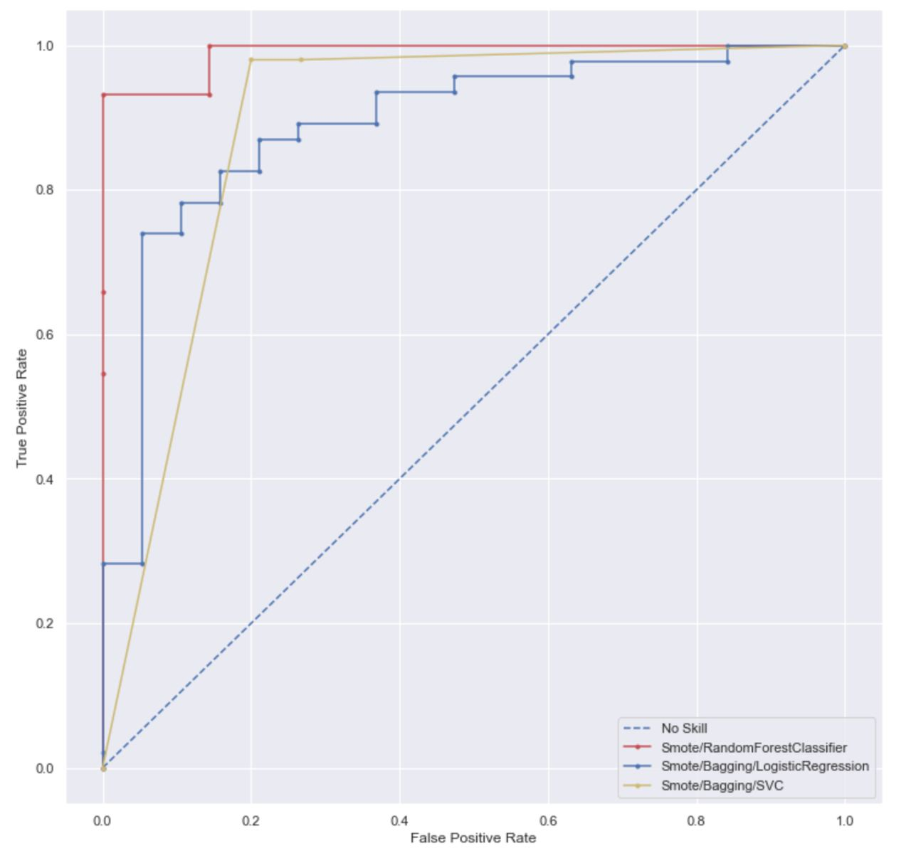
Evaluation
ROC_AUC_Score
Random Forest gave us the best AUC score and the lowest variance distribution
SVC gives the best F1 score

Slide 13
Evaluation
ROC_AUC_Score
Visually Random Forest gave the lower variance distribution
SVC using Bagging gives the highest FP score
But, Logistic Regression using Bagging gives the best separation between labels

Slide 14
Evaluation Random state\Test size affect distribution (F1 score)
Test size
Random state

Slide 15
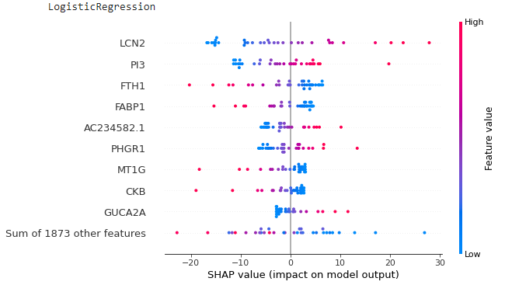
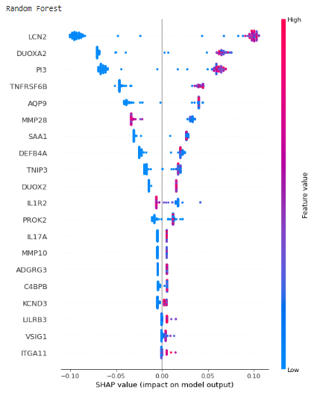
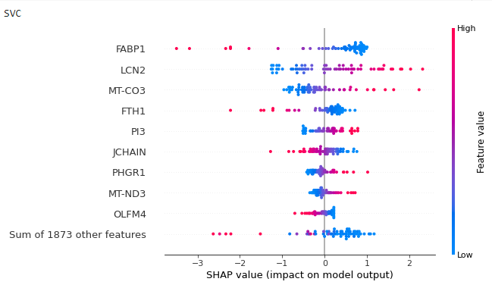
Evaluation Feature importance using SHAP explainer
A few genes were found to be important in at least two out of 3 three different models
Notes:
Future research is required to reveal the genes mechanisms which underlie the disease severity

Slide 16
Evaluation Feature importance using SHAP explainer
A few genes were found to be important in two out of 3 three different models
Random forest
LogisticRegression
SVC
Notes:
Future research is required to reveal the genes mechanisms which underlie the disease severity

Slide 17
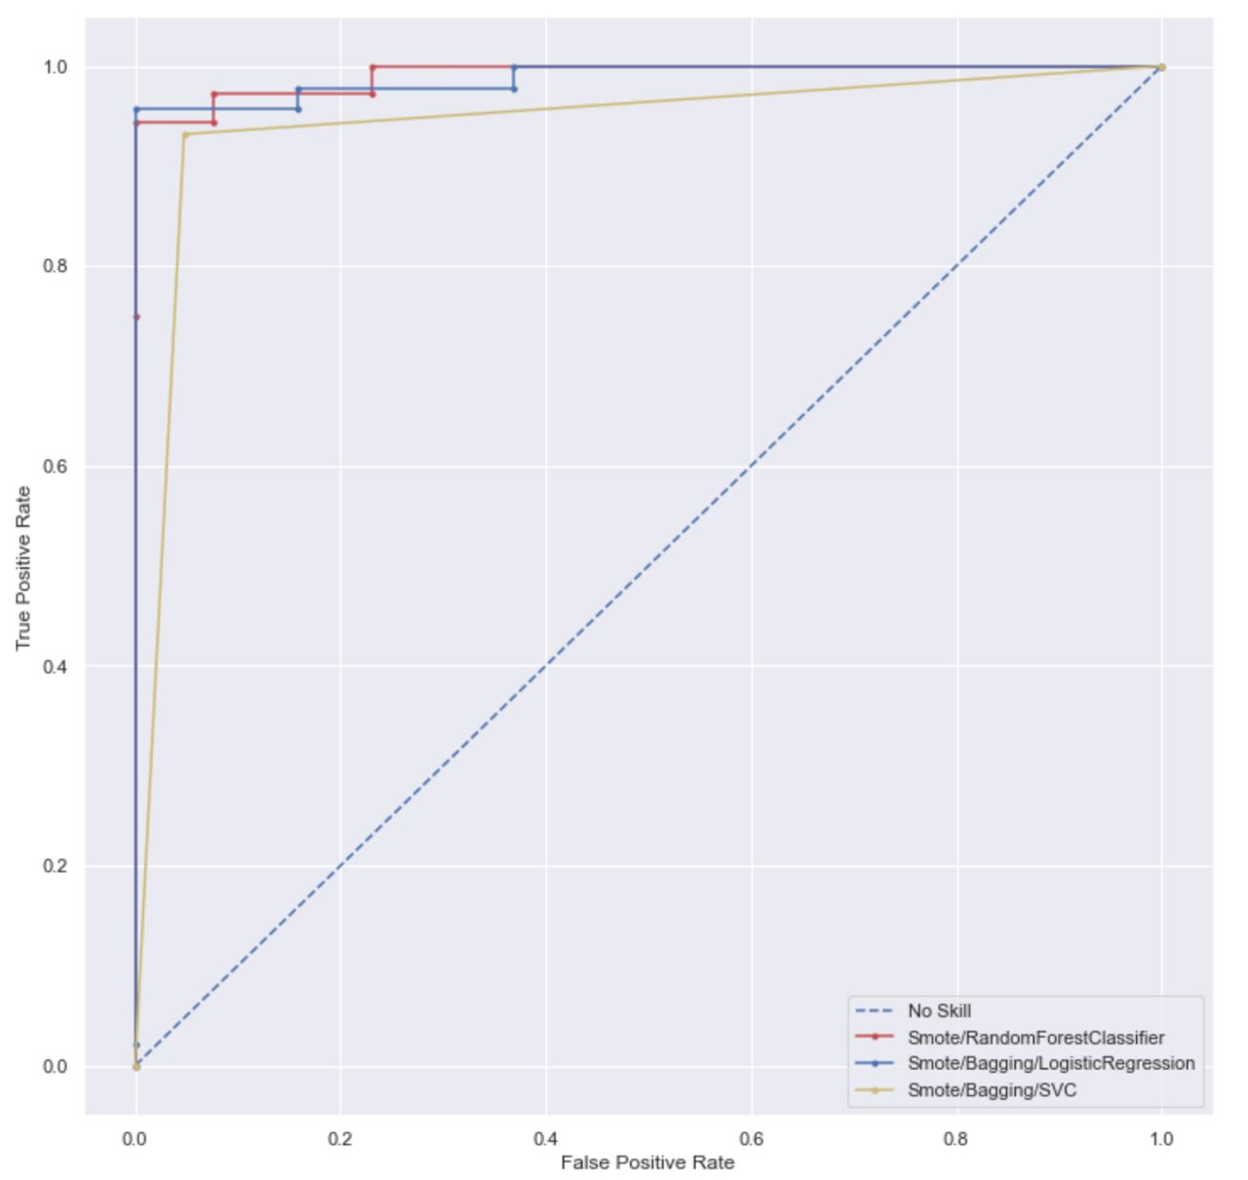

Evaluation – After The Feature Selection ROC_AUC_Score
Logistic Regression and Random Forest had close AUC scores, which was better than that of SVC.
SVC gives the lowest AUC score. This means that these models might produce more FP classifications

Slide 18
Evaluation – After The Feature Selection ROC_AUC_Score
SVC gives the highest AUC score and thus, the best separation
Logistic Regression and Random Forest had close AUC scores, which were worse than that of SVC. This means that these models might produce more FP classifications

Slide 19
Feature Selection
Using the ‘most important’ features to determine the F1\log-loss score
After
Before

Slide 20
Evaluation – After Feature Selection Random state\Test size affect distribution (F1 score)
Test Size
Random State

Slide 21
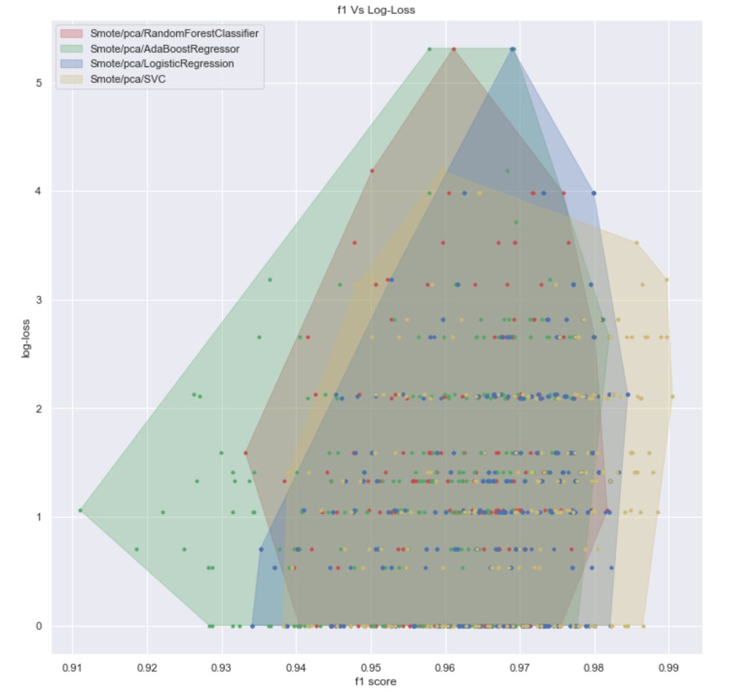
Feature reduction using Principal component analysis

Slide 22

Insights & Conclusion
The model selection should be based on the business question
Best F1 => SVC using SMOTE & Bagging
Best separation => Inconclusive
Our Feature selection increased the variance in all models
Changing the test size\random state causes different scores due to the small sample size

Slide 23

Next Steps
Enriching our data for both UC/Control groups
Further investigation of the overlapping important genes between the different models
Implementing the model to predict UC remission
Implementing the model to predict which treatment method is most effective

Slide 24


